Slide 1
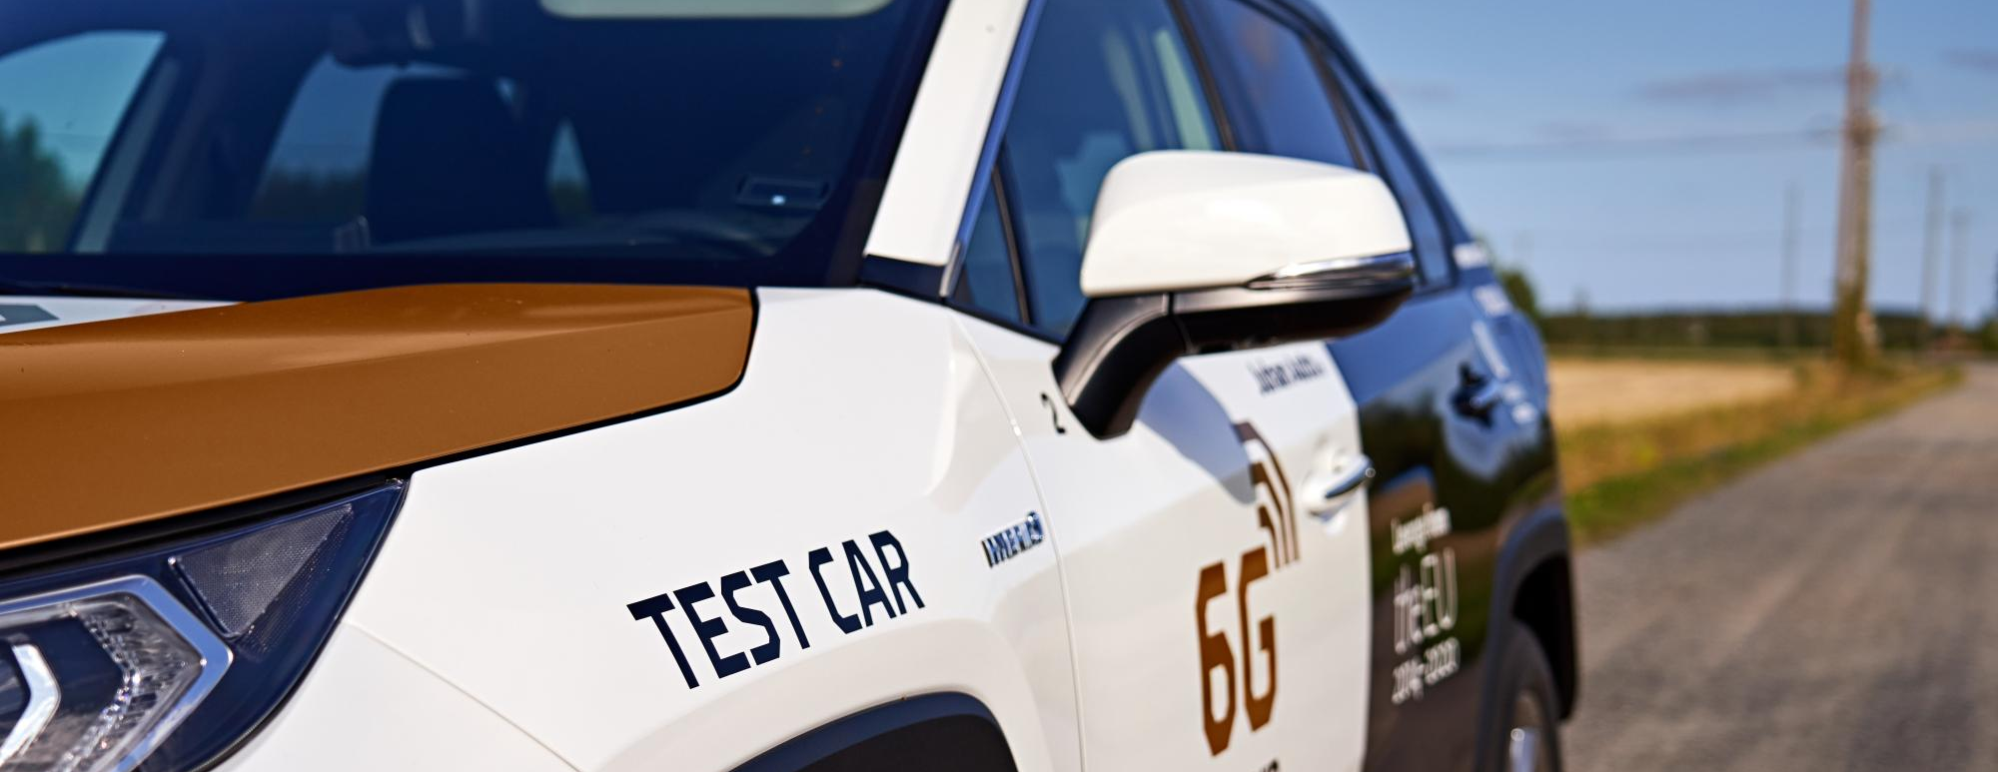
6G Visible Project: M3S Research Group
Supervisor: Vishaka Basnayake
5G/6G Service and Architecture Solutions for Autonomous Driving

Slide 2
Initial Task Plan for the Summer Internship
Month | Week | Task | Deliverable
May | 5th Week | Orientation and familiarization with the University of Oulu's 6GVisible project and defining the specific aim, objectives and deliverables for the two-month summer training as part of 6GVisible. | -
June | 1st Week | Review of Existing Datasets on Network Traffic from Non, Semi, and Fully Autonomous Vehicles. | Datasets for Network Traffic/Usage Prediction
 | 2nd Week | Review of existing ML methods for predicting network traffic from autonomous driving using historical data. | Exisiting ML methods for Network Traffic/Usage Prediction
 | 3rd Week | Develop a network demand prediction model for 5/6G-enabled autonomous driving. | Customized ML model for Network Demand Prediction
 | 4th Week | Validate and refine the predictive model using available data. | Validated ML model
July | 1st Week | Review of 3GPP, ITU standards and parameters for Cellular V2X enabled autonomous driving | Table summarizing the Standards of V2V, V2I, V2N, V2P
 | 2nd Week | Review of existing simulation software's for assessing network availability for massive autonomous driving. | Table summarizing the comparision between 5/6G simulation software tools
 | 3rd Week | Comparision of network simulations of 5/6G enabled autonomous driving with network demand predictions. | Comparision between Network Demand Simulation and Predicition
 | 4th Week | Summarize the findings in a research paper | Research Paper (Draft) and Presentation

Slide 3
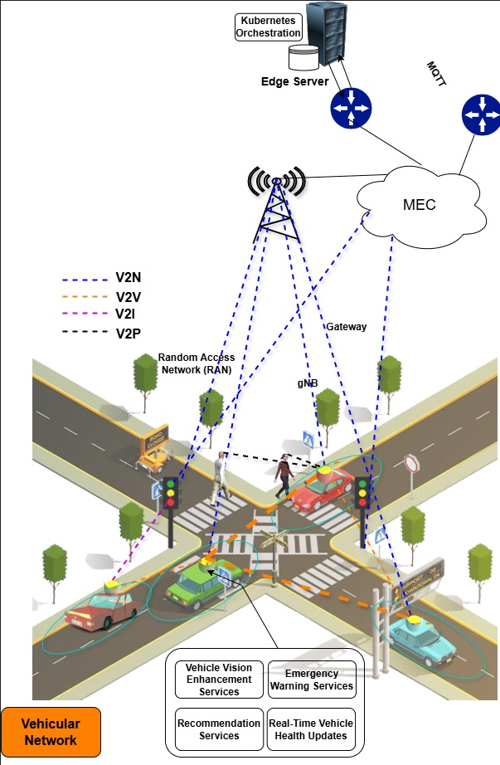
Key Areas of Focus:
The research focuses on the V2N network primarily, and its reliability
Exploit the Challenges and Limitations of Autonomous Driving in the current Radio Access Network(RAN)
Identify the main factors affecting Autonomous Driving (Vehicle speed, Whether conditions, Terrain Issues, Interferences)
Identify Reference Signal Received Power (RSRP) for definite use cases for 5G Network , and prose and define RSRP thresholds for the Autonomous Driving in 5G-NSA network

Slide 4


Slide 5
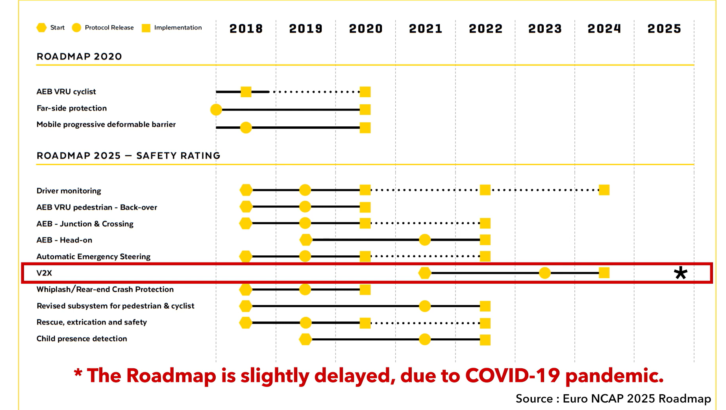

Slide 6
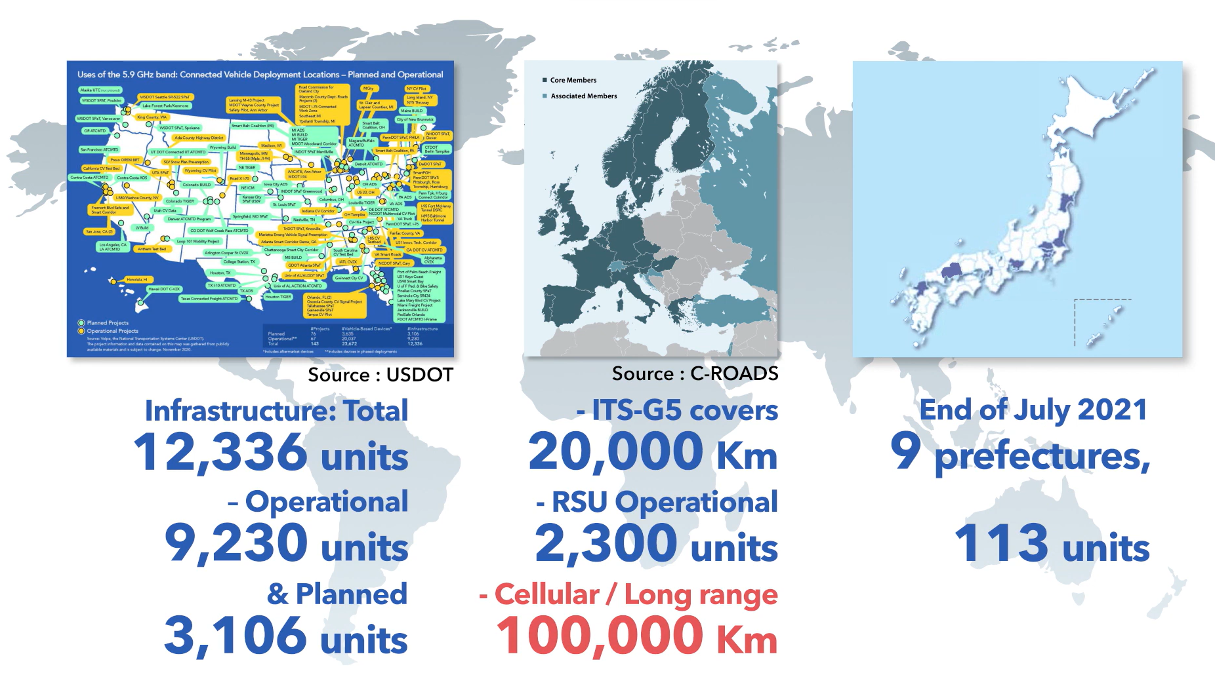
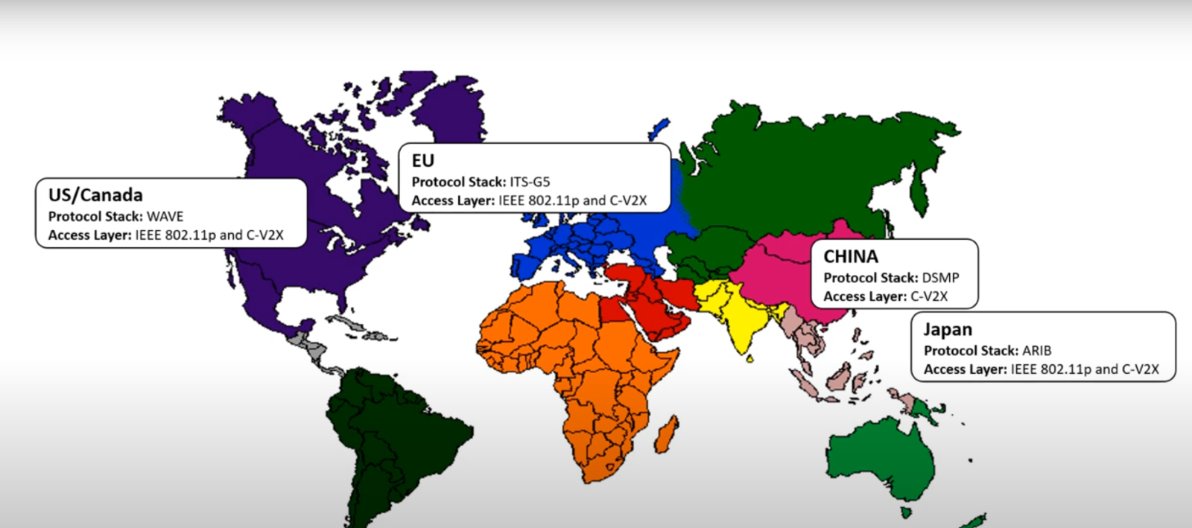
Infrastructure / Standards and Protocols

Slide 7
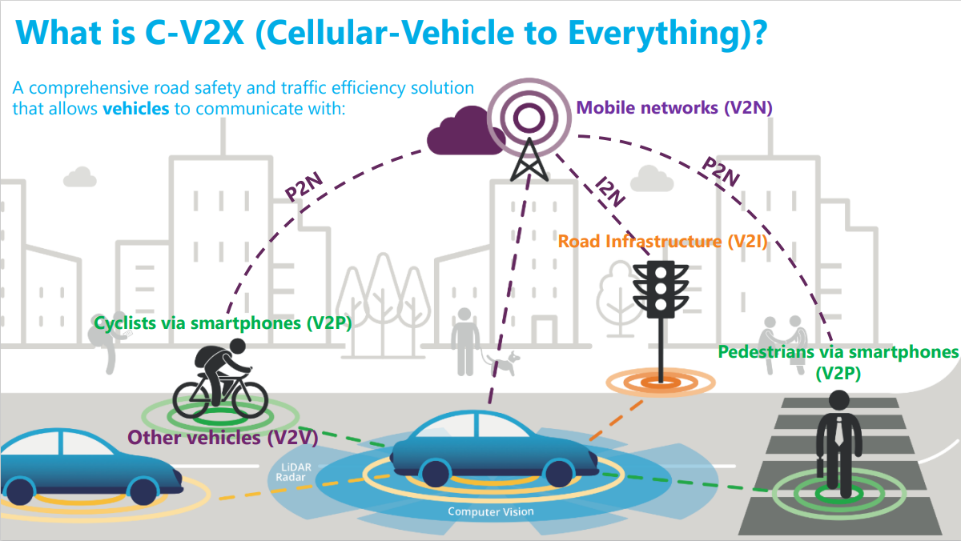

Slide 8
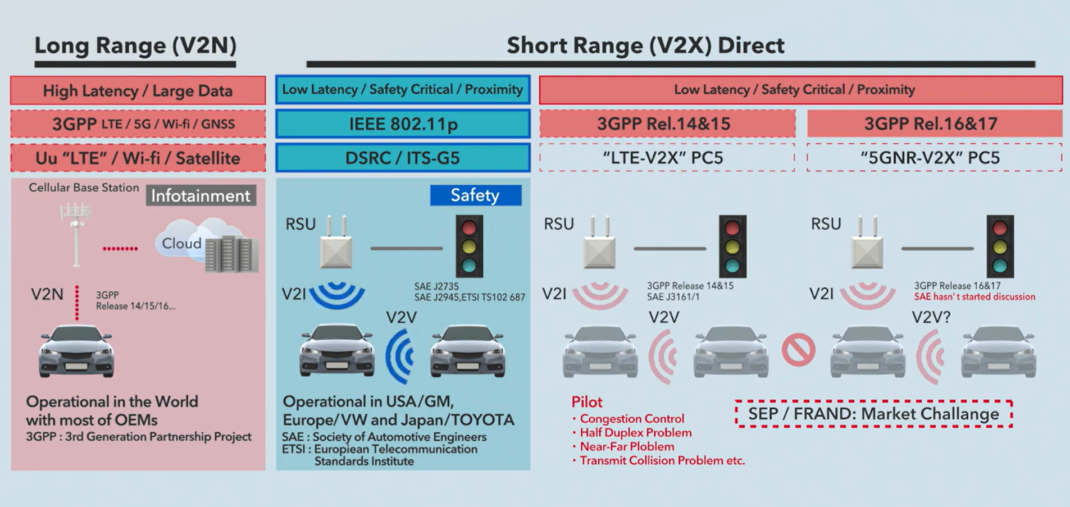
This is a combination of politics, technology and frequency

Slide 9
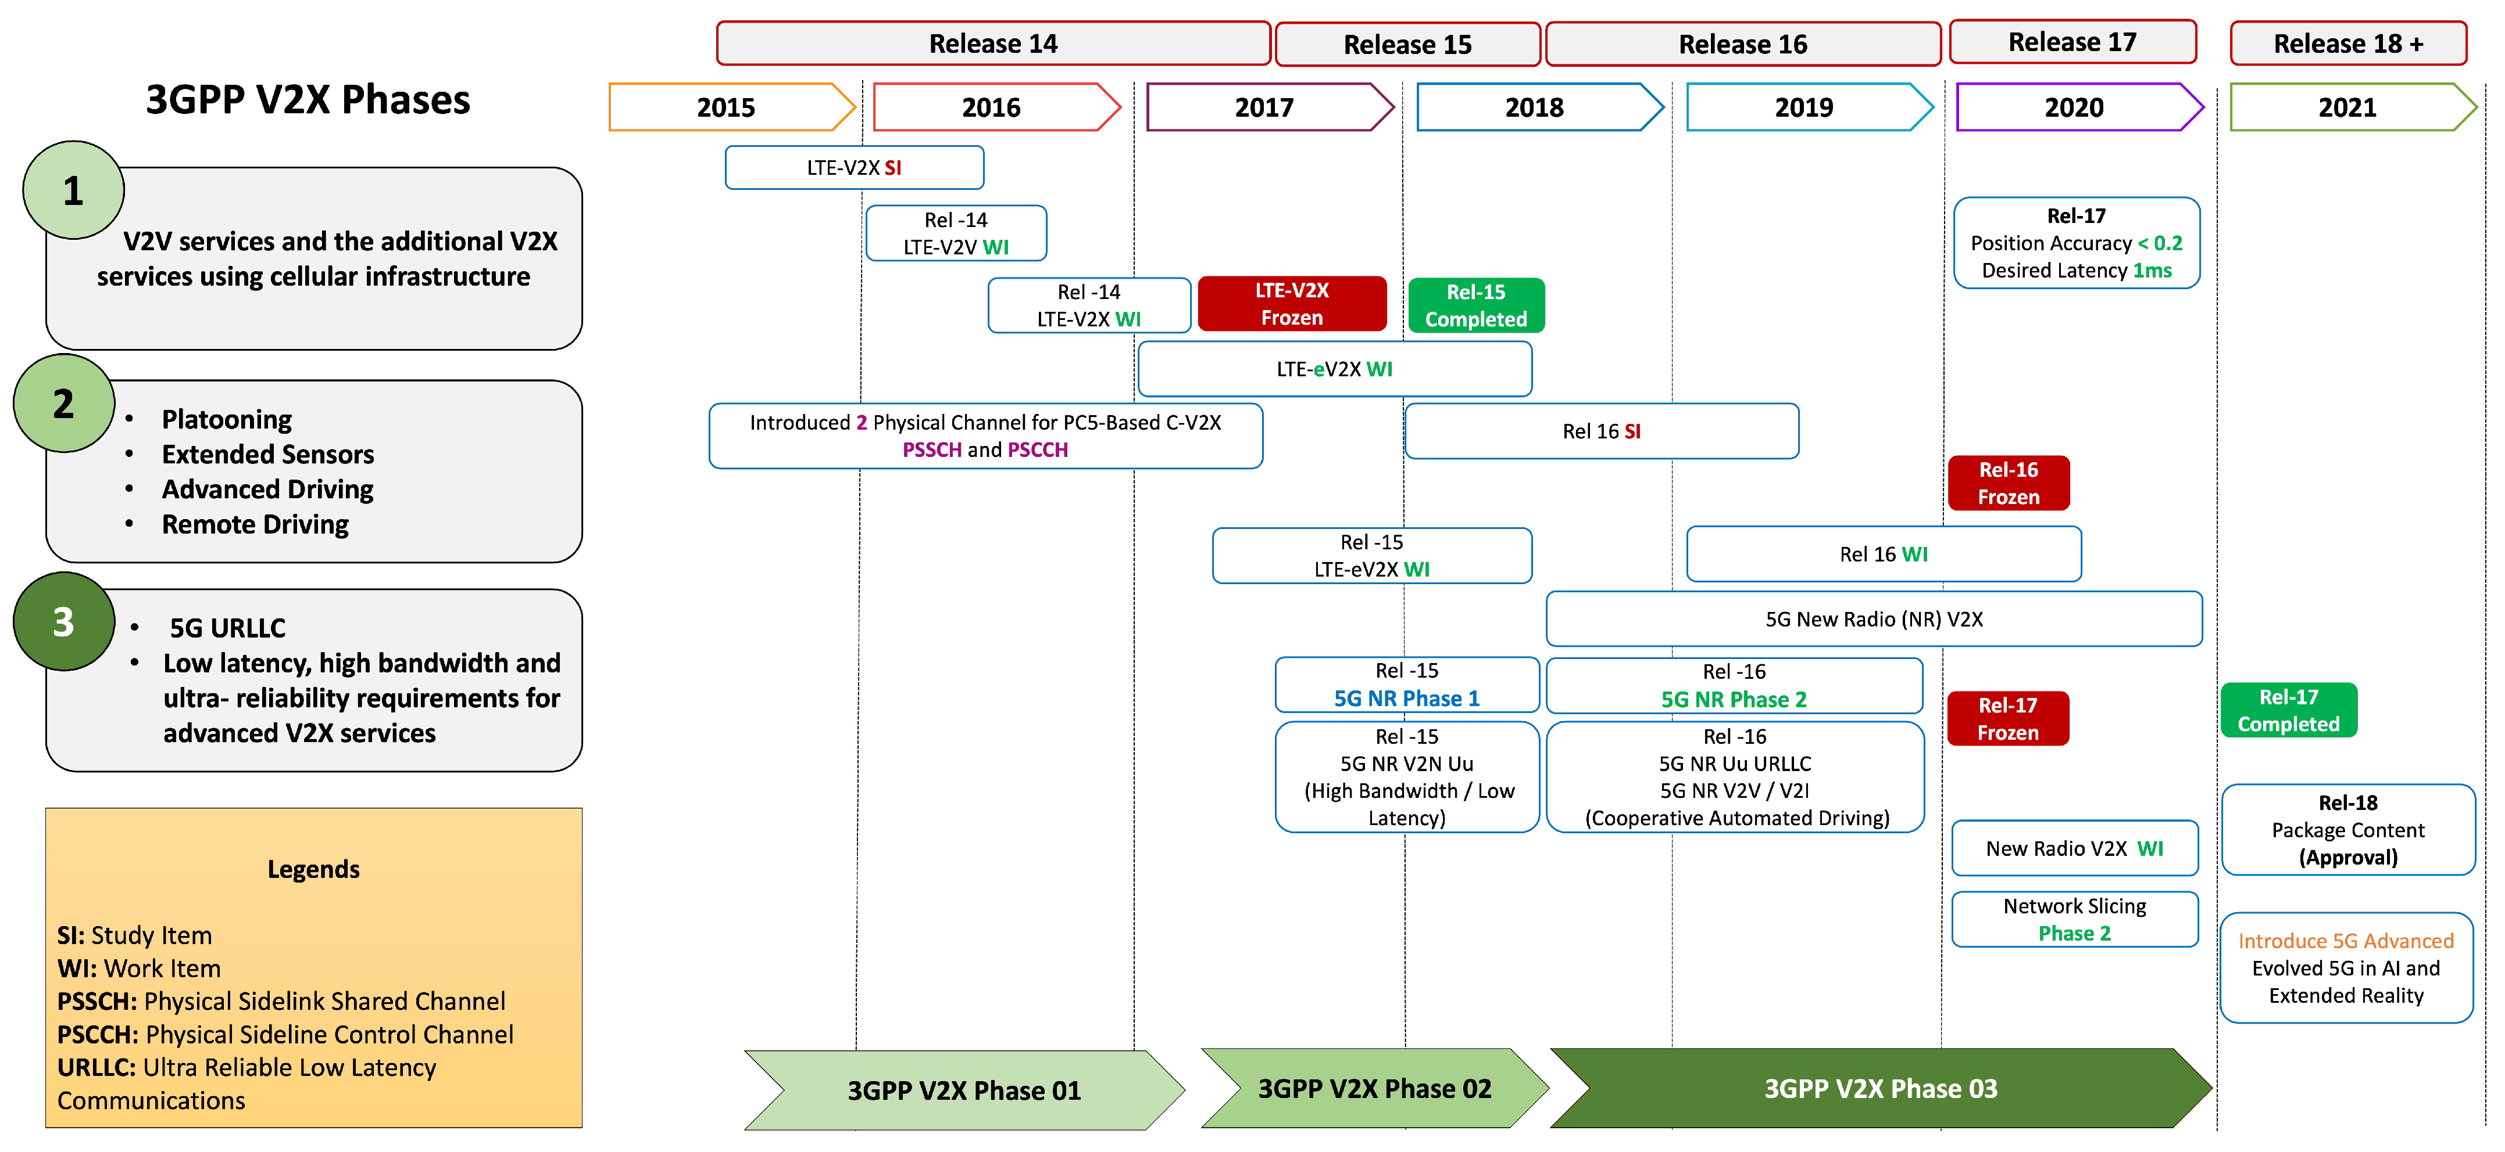

Slide 10
Use Cases
Parameter | Value
Periodic Broadcast Messages | Minimum: 0.004 Mbps , Maximum: 0.024 Mbps
Event-Triggered Messages | Maximum: 0.096 Mbps
Range Requirements | The E-UTRAN shall be capable of supporting a communication range sufficient to give the driver(s) ample response time (e.g., 4 seconds).
Speed Requirements | maximum relative velocity of 500 km/h
Latency/ Reliability | V2V/P-100ms,V2V-20ms,V2I-100ms,V2N max 1000ms
Communication scenario | Description | Lower-degree automation |  | Higher-degree automation
 |  | Max end-to-end latency (ms) | Data rate (Mbps) | Max end-to-end latency (ms) | Data rate (Mbps)
vehicle platooning | Cooperative driving | Lowest degree:25 Low degree: 20 | - | Highest degree: 10 High degree: 20 | Highest degree: 65
 | Information sharing | 20 | - | Higher degree: 20 | 50
 | Reporting | 500 | - | - | -
Advanced Driving | Cooperative collision avoidance | - | - | 10 | 10
 | Information sharing | 100 | - | 100 | 53
 | Emergency trajectory alignment | - | - | 3 | 30
 | Cooperative lane change | 25 | - | 10 | -
 | Video sharing | - | - | - | UL: 10
Extended Sensors | Sensor information sharing | 100 | - | Highest degree: 3 High degree: 10 | Highest degree: 50 High degree: 1000
 | Video sharing | 50 | 10 | Highest degree: 10 High degree: 10 | Highest degree: 700 High degree: 90
Remote Driving |  | - | - | 5 | UL: 25 DL: 1

Slide 11
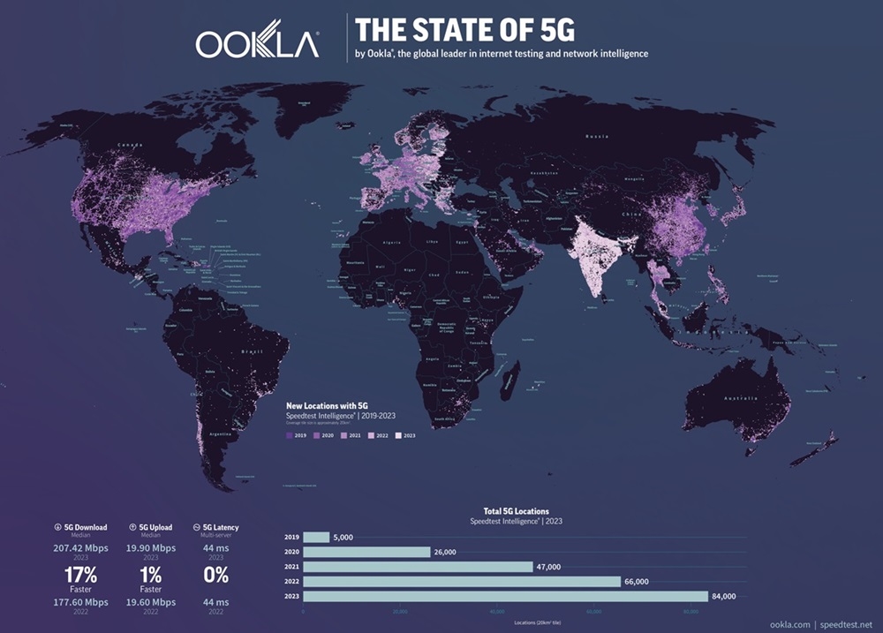
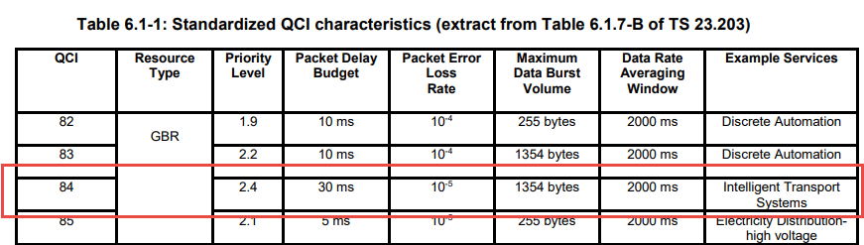
V2N latency
The global requirement for V2X network latency for Advanced Driving is 30 ms.
But based on the global throughput speed data, the current network’s latency in 5G network is 44ms based on the 84000 locations.
Ookla 2023 report

Slide 12
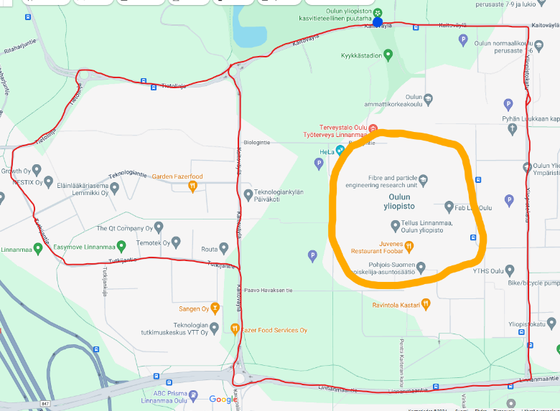
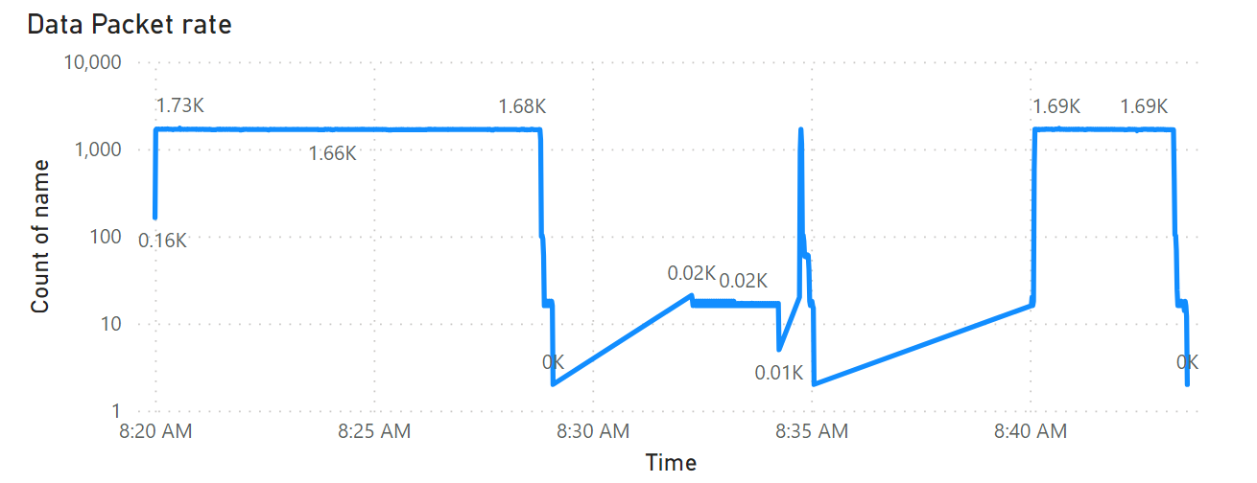
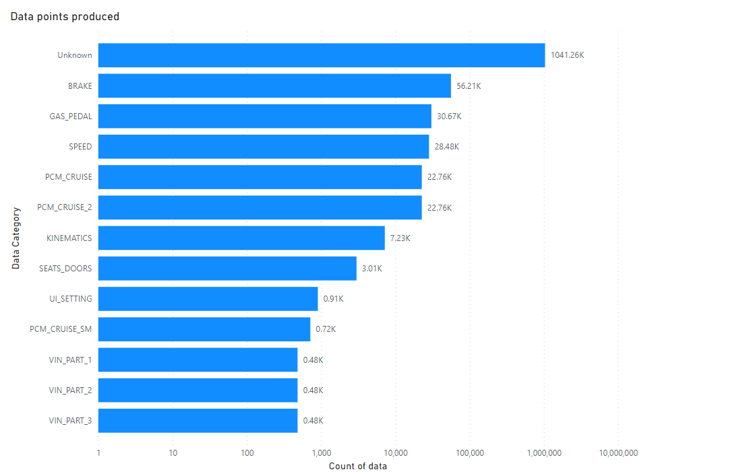
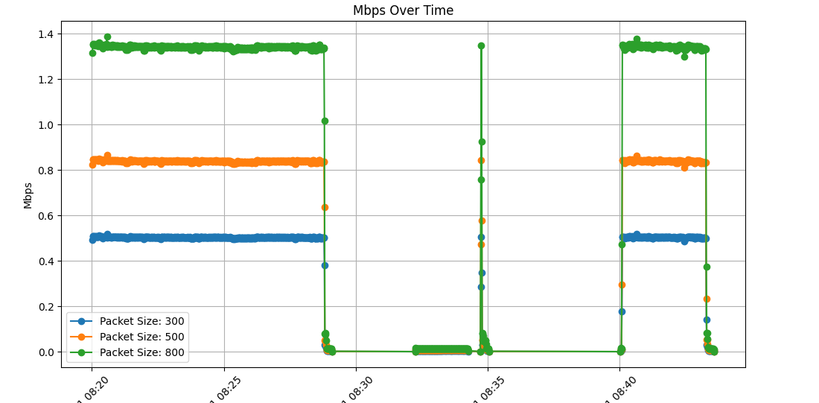
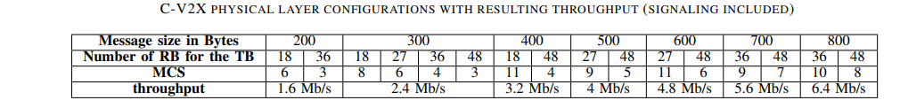
Data produced by the test Car
Approximate Distance: 5 km
Start Time: May 23, 2024, 08:20:00.209536
End Time: May 23, 2024, 08:43:36.127128
Time duration: 23 minutes and 36 seconds (1415.92 seconds)
Average speed: 12.71 km/h
Total data points:1.22 million
Total Data volume: 145 Mb

Slide 13
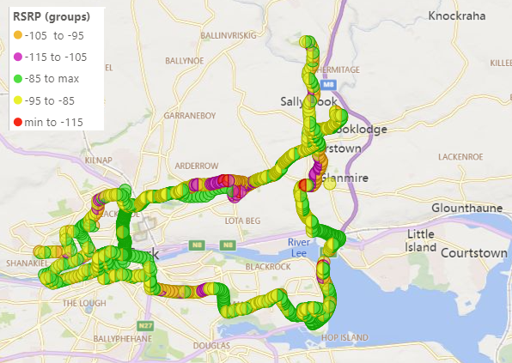
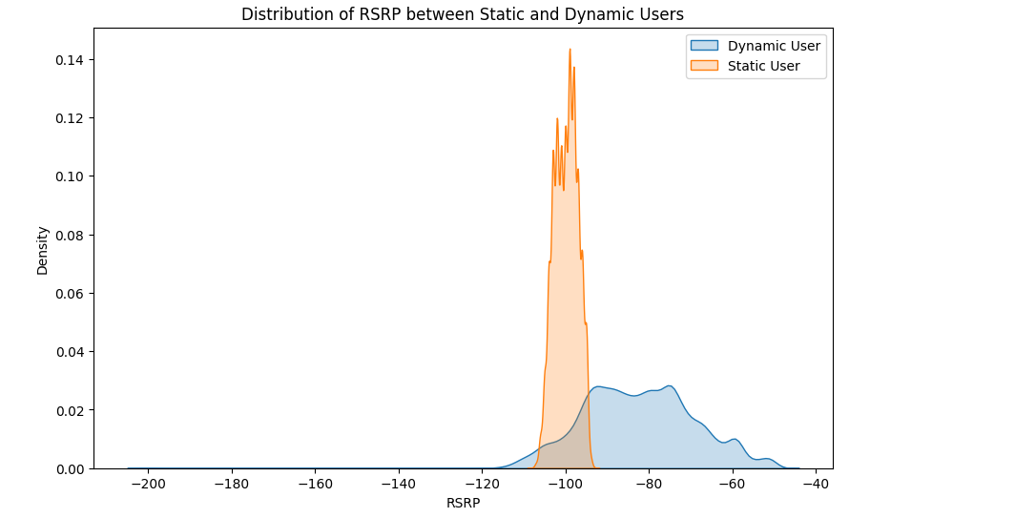
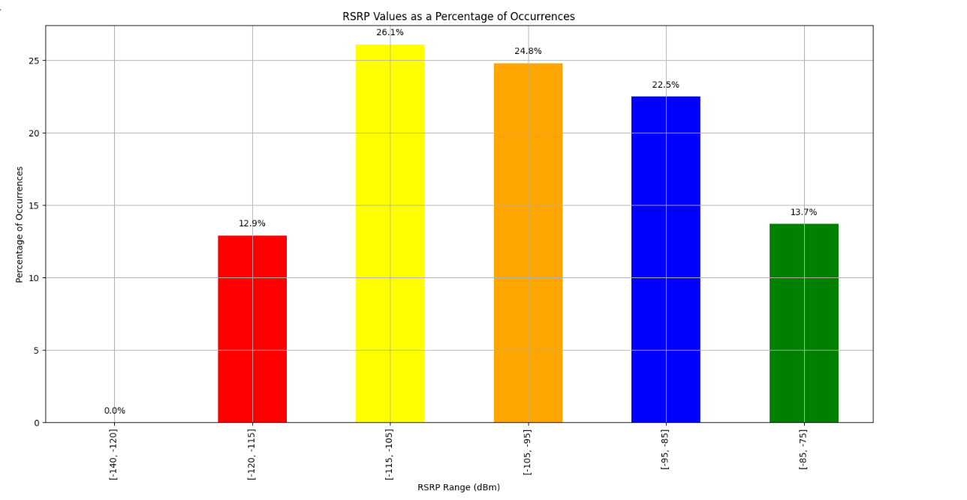
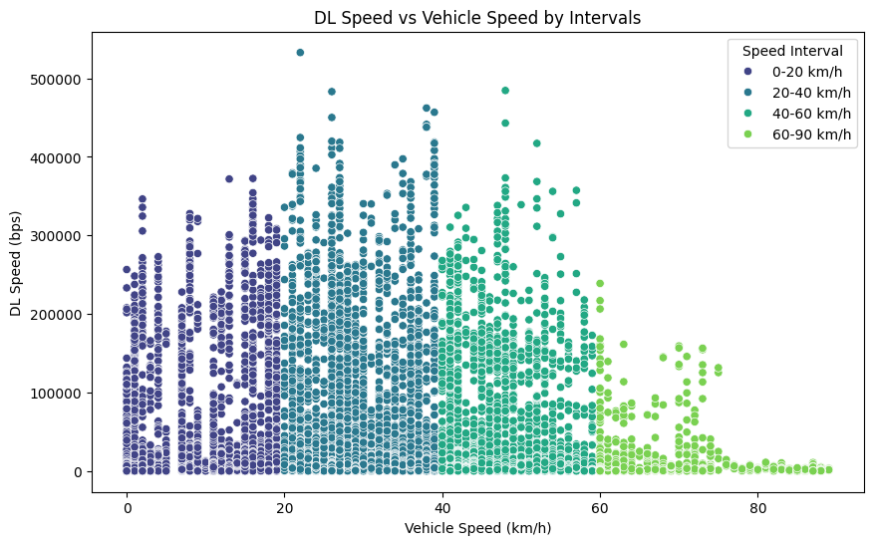
Analysis : Open Data set from Ireland

Slide 14
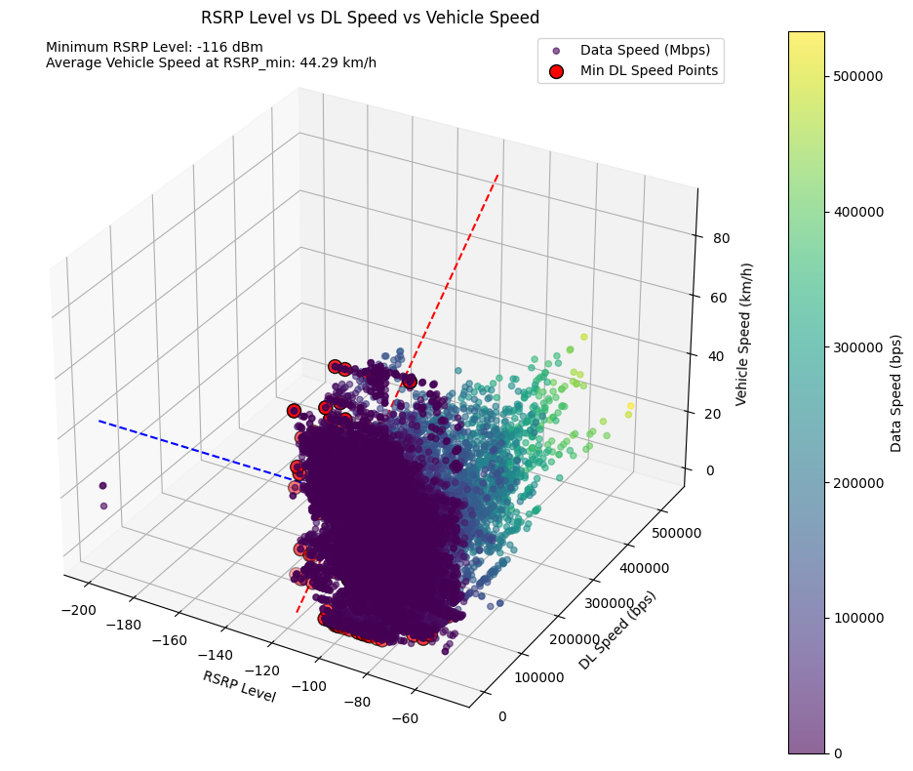
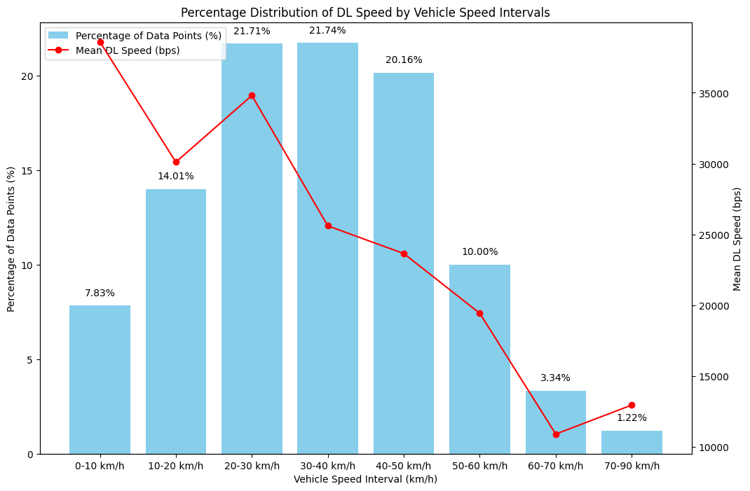
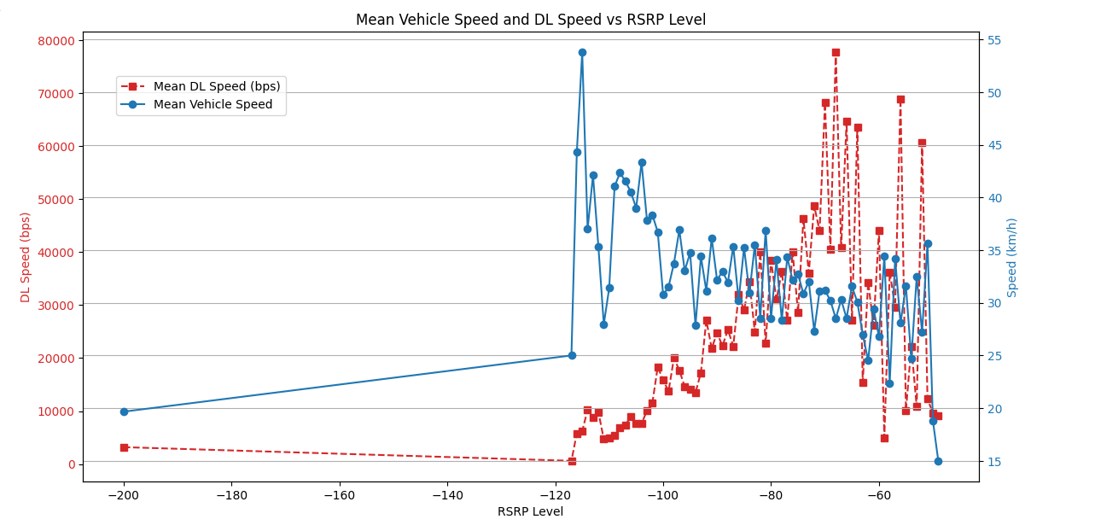
Speed Interval | Average RSRP level Recorded
0-10 km/h | -84.335493
10-20 km/h | -81.332730
20-30 km/h | -80.536150
30-40 km/h | -78.863811
40-50 km/h | -84.474555
50-60 km/h | -87.869518
60-70 km/h | -87.637351
70-90 km/h | -82.690476
90-150 km/h | -88.504438(PREDICTED)
150-200 km/h | -93.366099(PREDICTED)
200-250 km/h | -98.710506(PREDICTED)
By using ML: Intervals-based Polynomial regression
Will be tested in Sodankylä test track
Here we have identified the -116 as the minimum level at an average vehicle speed of 44.29 Kmph.
Network Mode | Record Count | Average of DL_bitrate | Max of RSRP | Min of RSRP | Average of RSRP
5G | 13959 | 46175,26 | -50 | -116 | -82,8
HSDPA | 41 | 1145,68 | -71 | -91 | -87,5
HSPA+ | 4338 | 3352,02 | -51 | -101 | -70,5
HSUPA | 41 | 20,85 | -57 | -95 | -85,5
LTE | 9204 | 11113,40 | -49 | -200 | -87,3
UMTS | 8 | 0,00 | -77 | -95 | -83,5
Grand Total | 27591 | 27597,30013 | -49 | -200 | -82,37

Slide 15
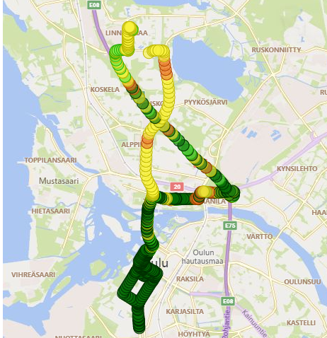
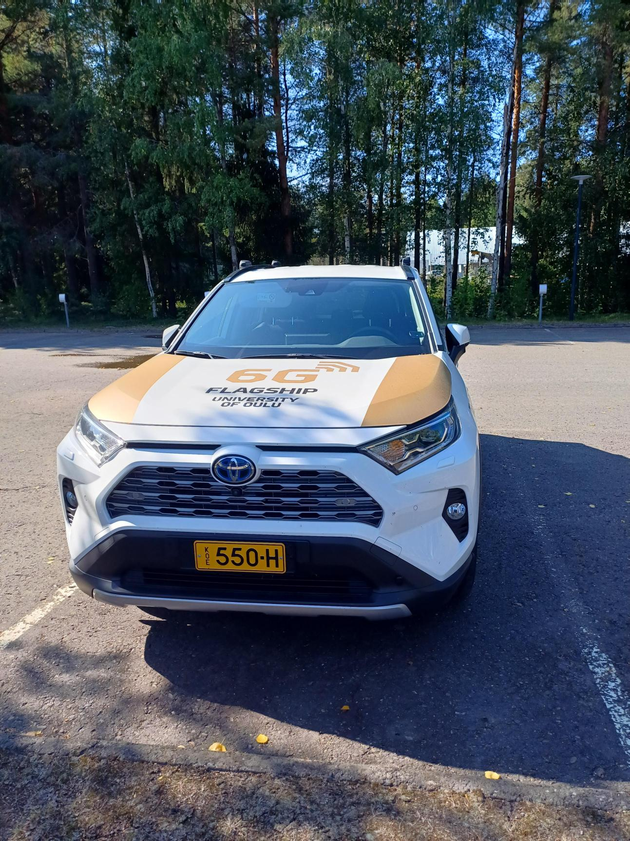
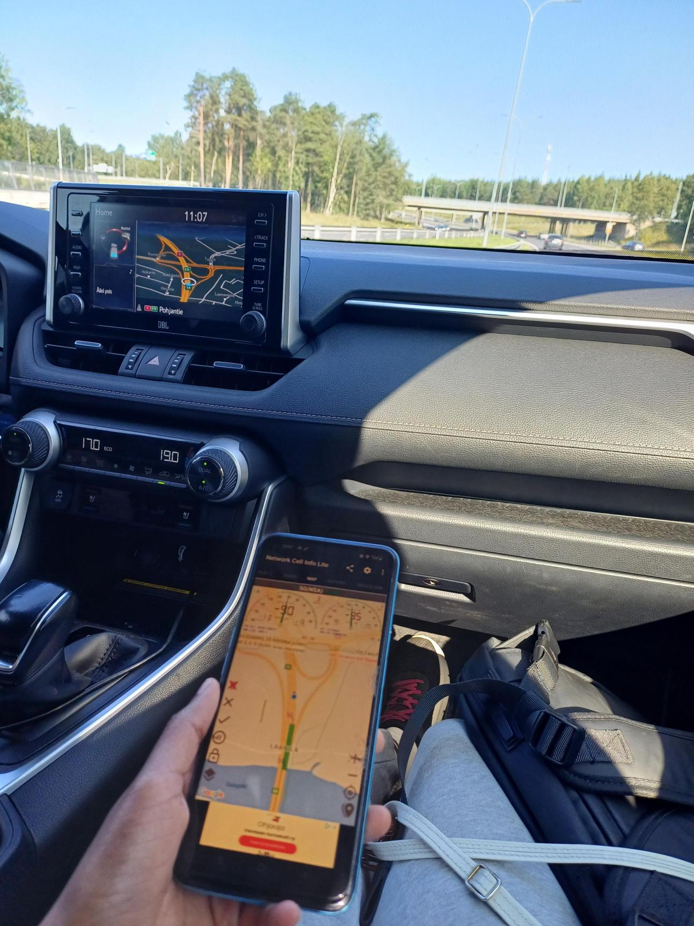
Drive Testing at Oulu
No | TEST | Content | Operator A | Operator B
1 | HTTP Download Speed Test | Iterative Download of file size 10 GB. | ✓ | ✓
2 | HTTP Upload Speed Test | Iterative Download of file size 10 GB. | ✓ | ✓
3 | Ping Test | Continuous HTTP Ping test | ✓ | ✓
4 | Live Vide Stream test | 4K Youtube Live Streaming | ✓ | -

Slide 16
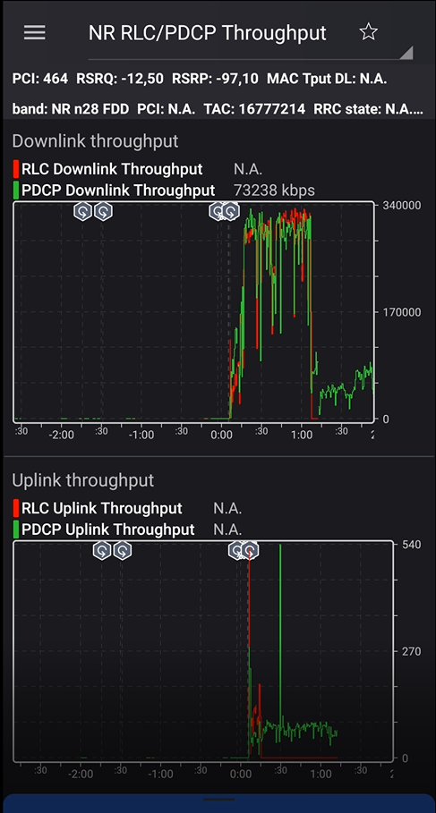
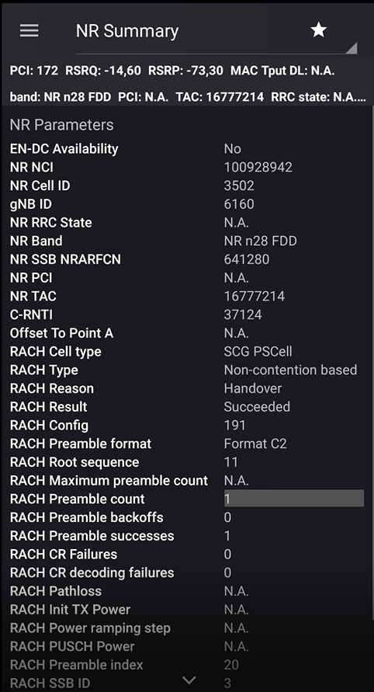
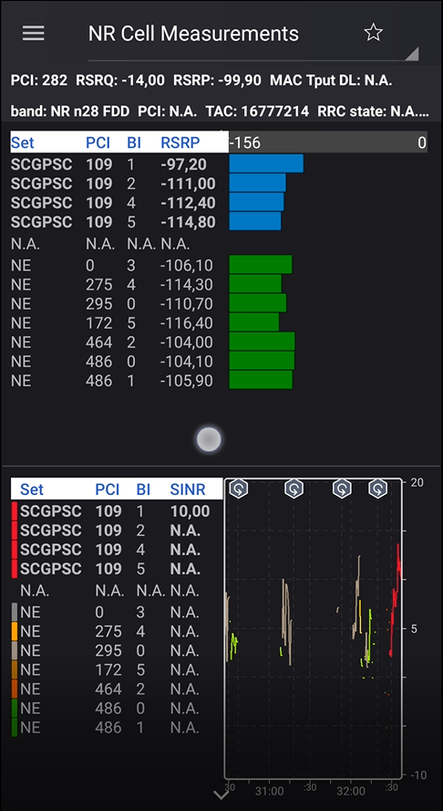
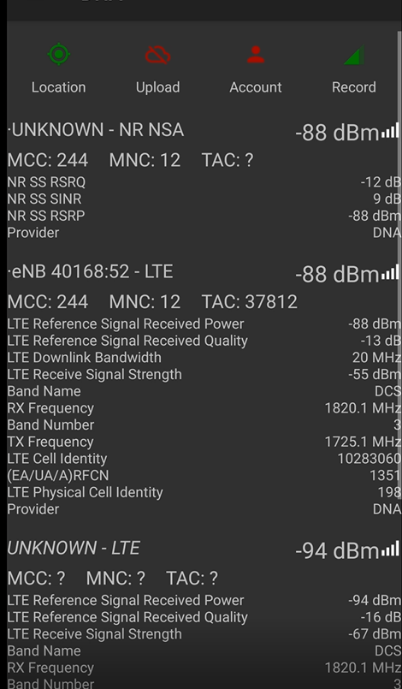
Nemo Handy
OnePlus/LE2123

Slide 17
Test Results: Signaling Parameters and Throughput
Test Case | Parameter | Operator A | Operator B | Summary
DL | RSRP max | -59.40 | -47.20 | -53.30
 | RSRP min | -114.70 | -100.90 | -107.80
 | RSRP avg | -77.49 | -66.34 | -71.92
 | RSRQ max | -5.60 | -4.00 | -4.80
 | RSRQ min | -27.40 | -26.80 | -27.10
 | RSRQ avg | -15.34 | -12.72 | -14.03
 | SNR max | 29.5 | 25.200001 | 27.35
 | SNR min | -10.2 | -9.8 | -10.000
 | SNR avg | 16.140867 | 11.889452 | 14.015
UL | RSRP max | -55.65 | -59.15 | -57.40
 | RSRP min | -108.25 | -106.25 | -107.25
 | RSRP avg | -70.17 | -73.42 | -71.80
 | RSRQ max | -2.75 | -2.30 | -2.53
 | RSRQ min | -29.35 | -24.15 | -26.75
 | RSRQ avg | -10.89 | -10.60 | -10.75
 | SNR max | 28.850 | 25.700001 | 27.275
 | SNR min | -9.300 | -7.75 | -8.525
 | SNR avg | 16.949 | 12.787419 | 14.868
Live Streaming | RSRP max | -66.6000025 | - | -66.6000025
 | RSRP min | -116.299999 | - | -116.299999
 | RSRP avg | -84.0067675 | - | -84.0067675
 | RSRQ max | -3 | - | -3
 | RSRQ min | -26.6 | - | -26.6
 | RSRQ avg | -10.970128 | - | -10.970128
 | SNR max | 24.50 | - | 24.50
 | SNR min | -12.70 | - | -12.70
 | SNR avg | 12.35 | - | 12.35
Ping | RSRP max | -74.849998 | -62.950001 | -68.8999995
 | RSRP min | -101.650002 | -105.700001 | -103.6750015
 | RSRP avg | -85.5591735 | -78.9102095 | -82.2346915
 | RSRQ max | -6.85 | -3.25 | -5.05
 | RSRQ min | -22.799999 | -23.25 | -23.0249995
 | RSRQ avg | -11.3117405 | -10.5186315 | -10.915186
 | SNR max | 17.5500005 | 22.6000005 | 20.0750005
 | SNR min | -5.2 | -5.55 | -5.375
 | SNR avg | 9.00482 | 11.5415425 | 10.27318125
Parameter | Operator A all the Test cases | Operator B all the Test cases | Summary all the Test cases
RSRP max | -64.13 | -56.43 | -60.28
RSRP min | -110.22 | -104.28 | -107.25
RSRP avg | -79.31 | -72.89 | -76.10
RSRQ max | -4.55 | -3.18 | -3.87
RSRQ min | -26.54 | -24.73 | -25.64
RSRQ avg | -12.13 | -11.28 | -11.70
SNR max | 25.10 | 24.50 | 24.80
SNR min | -9.35 | -7.70 | -8.525
SNR avg | 13.61 | 12.07 | 12.842
Parameter | Operator A | Operator B | Summary
App Tput UL max(Mbps) | 95.859232 | 113.883611 | 104.8714215
App Tput UL avg(Mbps) | 41.131676 | 41.588176 | 41.359926
App Tput DL max(Mbps) | 586.869696 | 827.4864 | 707.178048
App Tput DL avg(Mbps) | 78.002192 | 147.763168 | 112.88268
RTT includes processing delay at the echoing endpoint. We have assumed Latency as the half of the RTT

Slide 18
Test Results: Handovers and Latency
Test Case | Parameter | Operator A | Operator B | Summary
DL | Handover attempts | 78 | 58 | 136
 | Handover success | 77 | 58 | 135
 | Handover failures | 1 | 0 | 1
 | Handover success rate | 98 | 100 | 99
UL | Handover attempts | 85 | 75 | 160
 | Handover success | 85 | 75 | 160
 | Handover failures | 0 | 0 | 0
 | Handover success rate | 100 | 100 | 100
Live Streaming | Handover attempts | 72 | - | 72
 | Handover success | 72 | - | 72
 | Handover failures | 0 | - | 0
 | Handover success rate | 100 | - | 100
Ping | Handover attempts | 52 | 66 | 344
 | Handover success | 52 | 66 | 588
 | Handover failures | 0 | 0 | 1104
 | Handover success rate | 100 | 100 | 100
Parameter | Operator A all the Test cases | Operator B all the Test cases | Summary all the Test cases
Handover attempts | 287 | 199 | 486
Handover success | 286 | 199 | 485
Handover failures | 1 | 0 | 1
Handover success rate | 99.5 | 100.0 | 99.75
Test Parameter | Operator A | Operator B | Summary | Assumed Latency
Ping success rate | 100 | 100 | 100
Ping attempt | 1038 | 1749 | 2787
Ping success | 1038 | 1749 | 2787
Ping failed | 0 | 0 | 0
Ping RTT min | 25.5 | 25 | 25.25 | 12.63
Ping RTT max | 321.5 | 746.5 | 534 | 267.00
Ping RTT avg | 46.1754245 | 49.5475865 | 47.8615055 | 23.93
RTT includes processing delay at the echoing endpoint. We have assumed Latency as the half of the RTT

Slide 19
Analysis
Communication scenario | Description | Test Results by Oulu 5G NSA Network
 |  | Lower-degree automation |  | Higher-degree automation
 |  | latency | Data rates | latency | Data rates
vehicle platooning | Cooperative driving | Possible | - | Not Possible | Possible
 | Information sharing | Not Possible | - | Not Possible | Possible
 | Reporting | Possible | - | - | -
Advanced Driving | Cooperative collision avoidance | - | - | Not Possible | Possible
 | Information sharing | Possible | - | Not Possible | Possible
 | Emergency trajectory alignment | - | - | Not Possible | Possible
 | Cooperative lane change | Possible | - | Not Possible | -
Extended Sensors | Sensor information sharing | Possible | - | Not Possible | Not Possible
 | Video sharing | Possible | Possible | Not Possible | Not Possible
Remote Driving |  | - | - | Not Possible | Possible
Note: The throughput values are considered as an average over the entire DT. However,
It should be analyzed as a percentage of the recorded throughput values at each time Interval.
This needed to be analysed via Nemo/ Actix Analyzer.
Min /Max and Avg RSRP values to achieve those throughput values will be identified based on that.
Thresholds will be derived from those data.

Slide 20
Throughput Percentage from the whole journey above the Threshold
Parameter | Automation | Throughput Require (Mbps ) | Throughput Percentage from the whole journey above the Threshold |  | Average
 |  |  | Operator 1 | Operator 2
Periodic Broadcast Messages | Minumum Reqirement | Minimum DL 0.004 | 99.70 | 99.47 | 99.59
 | Minumum Reqirement | Maximum DL: 0.024 | 99.70 | 99.47 | 99.59
Event-Triggered Messages | Minumum Reqirement | Maximum DL: 0.096 | 99.55 | 99.43 | 99.49
vehicle platooning : | Cooperative driving : High-degree automation | High degree: 65 | 51.87 | 55.57 | 53.72
 | Information sharing : Higher-degree automation | Higher degree: 50 | 64.85 | 66.85 | 65.85
Advanced Driving | Cooperative collision avoidance | DL:10 | 96.55 | 93.23 | 94.89
 | Information sharing : Higher-degree automation | High degree: 53 | 61.94 | 64.39 | 63.17
 | Emergency trajectory alignment | DL: 30 | 82.91 | 80.25 | 81.58
 | Video sharing | UL: 10 | 93.74 | 76.26 | 85.00
Extended Sensors | Sensor information sharing: Higher degree automation | latenmscy (3ms): DL: 50 | 64.85 | 66.85 | 65.85
 |  | latency (50ms) : DL : 1000 | 0.00 | 0.00 | 0.00
 | Video sharing | Lower degree : 10 | 96.55 | 93.23 | 94.89
 |  | Higher degree: 700 | 0.00 | 0.93 | 0.47
Remote Driving | Higher-degree automation | DL: 1 | 99.45 | 99.29 | 99.37
 |  | UL: 25 | 75.38 | 34.29 | 54.84

Slide 21
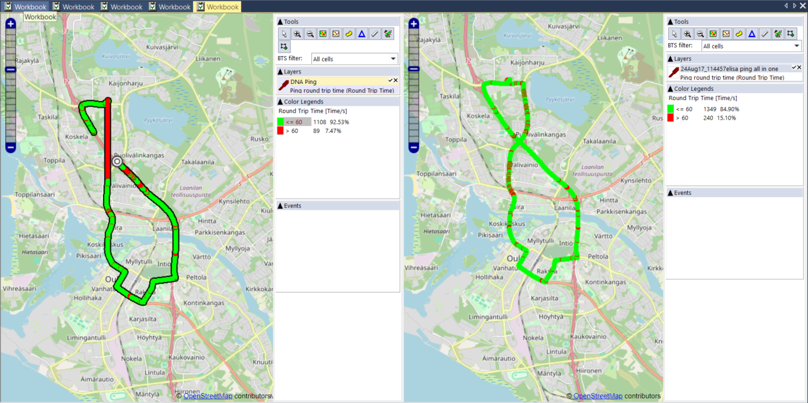
Latency Percentage from the whole journey above the Threshold
Communication scenario | Description | Lower-degree automation |  |  | Higher-degree automation
 |  | Max end-to-end latency (ms) | Operator 1 | Operator 2 | Max end-to-end latency (ms) | Operator 1 | Operator 2
vehicle platooning | Cooperative driving | Lowest degree:25 | 75.54 % | 66.24 % | Highest degree: 10 | 0 % | 0 %
 |  | Low degree: 20 | 28.53 % | 19.73 % | High degree: 20 | 28.53 % | 19.73 %
 | Information sharing | 20 | 28.53 % | 19.73 % | Higher degree: 20 | 28.53 % | 19.73 %
 | Reporting | 500 | 100 % | 99.58 % | - | - | -
Advanced Driving | Cooperative collision avoidance | - | - | - | 10 | 0 % | 0 %
 | Information sharing | 100 | 99.88 % | 99.39 % | 100 | 99.88 % | 99.39 %
 | Emergency trajectory alignment | - | - | - | 3 | 0 % | 0 %
 | Cooperative lane change | 25 | 75.54 % | 66.24 % | 10 | 0 % | 0 %
Extended Sensors | Sensor information sharing | 100 | 99.88 % | 99.39 % | Highest degree: 3 | 0 % | 0 %
 |  |  |  |  | High degree: 10 | 0 % | 0 %
 | Video sharing | 50 | 99.18 % | 95.40 % | Highest degree: 10 | 0 % | 0 %
 |  |  |  |  | High degree: 10 | 0 % | 0 %
Remote Driving |  | - | - | - | 5 | 0 % | 0 %
The global requirement for V2X network latency for Advanced Driving is 30 ms. | Operator 1 | Operator 2
 | 92.53 % | 84.90 %

Slide 22
RSRP Thresholds
Speed (Mbps) | DNA Min RSRP | DNA Max RSRP | DNA Avg RSRP | DNA Min Requirement | Elisa Min RSRP | Elisa Max RSRP | Elisa Avg RSRP | Elisa Min Requirement | Average Min RSRP | Average Max RSRP | Average Avg RSRP | Average Min Requirement
1 | -114.7 | -59.4 | -84.98 | -114.7 | -100.9 | -47.2 | -75.54 | -100.9 | -107.8 | -53.3 | -80.26 | -107.8
10 | -114.7 | -60.8 | -84.83 | -114.7 | -98.9 | -47.2 | -74.98 | -98.9 | -106.8 | -54 | -79.9 | -106.8
30 | -112.5 | -60.8 | -84.28 | -112.5 | -98.9 | -47.2 | -74.42 | -98.9 | -105.7 | -54 | -79.35 | -105.7
50 | -104.9 | -62.5 | -83.41 | -104.9 | -98.9 | -47.2 | -73.82 | -98.9 | -101.9 | -54.85 | -78.61 | -101.9
53 | -104.9 | -62.5 | -83.26 | -104.9 | -98.9 | -47.2 | -73.61 | -98.9 | -101.9 | -54.85 | -78.43 | -101.9
65 | -104 | -62.5 | -82.63 | -104 | -98.9 | -47.2 | -72.95 | -98.9 | -101.45 | -54.85 | -77.79 | -101.45
100 | -101.6 | -62.5 | -82.21 | -101.6 | -95.3 | -47.2 | -71.89 | -95.3 | -98.45 | -54.85 | -77.05 | -98.45
 |  |  |  |  |  |  |  |  |  |  | -77.97 | -100.925
Overall Low Threshold = -114.7
Overall Average Threshold = -100.92
Overall Good Threshold = -77.97

Slide 23
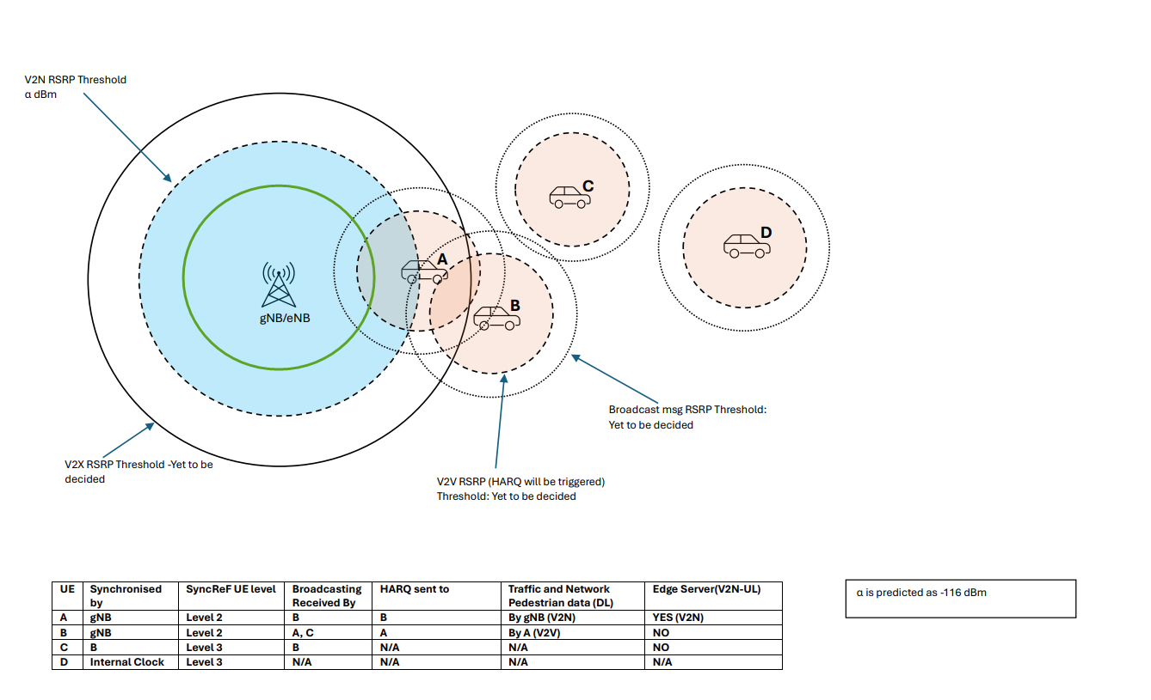
Proposed Models: V2X RSRP thresholds (In progress)

Slide 24
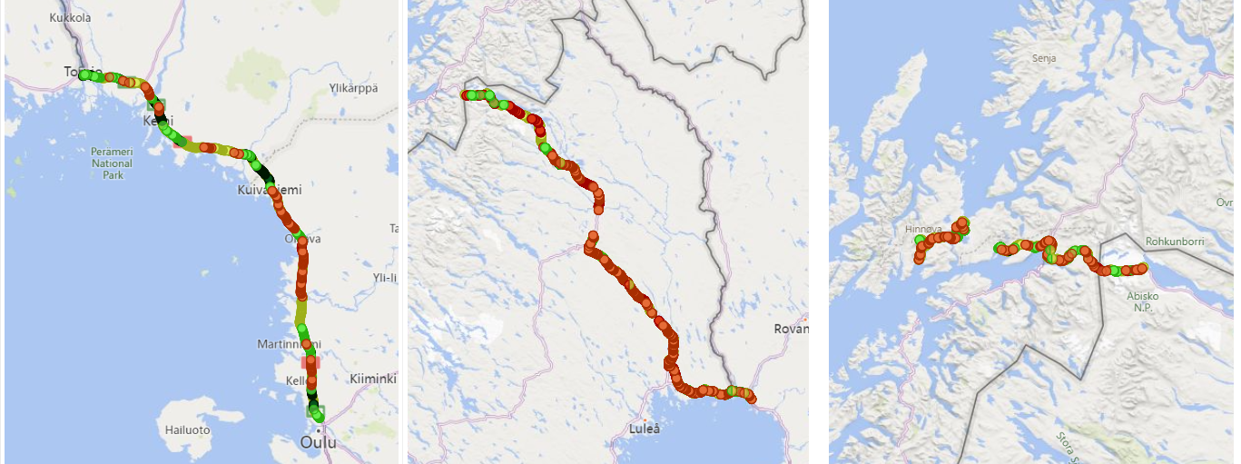
Analysis- Expressways country-wise comparison
Over 1000+ km
Across three Countries
Different terrains
With an average speed of 100 Kmph throughout the Journey
Over 140 unique cells

Slide 25
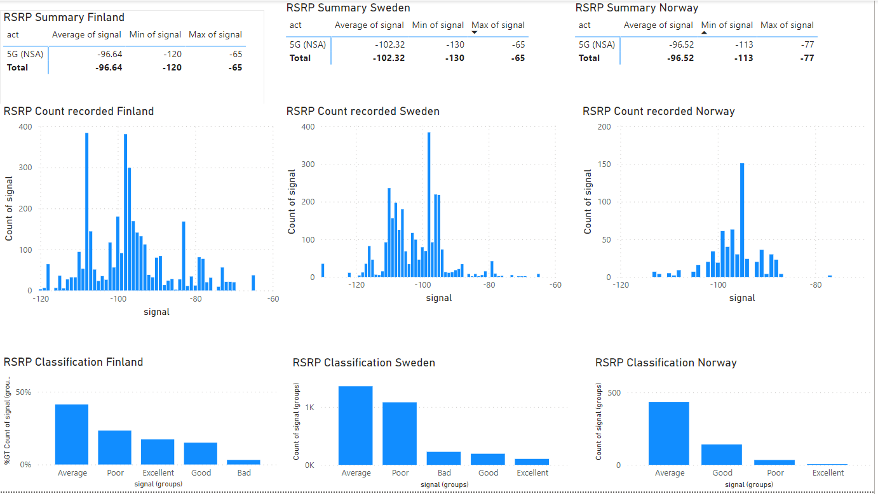
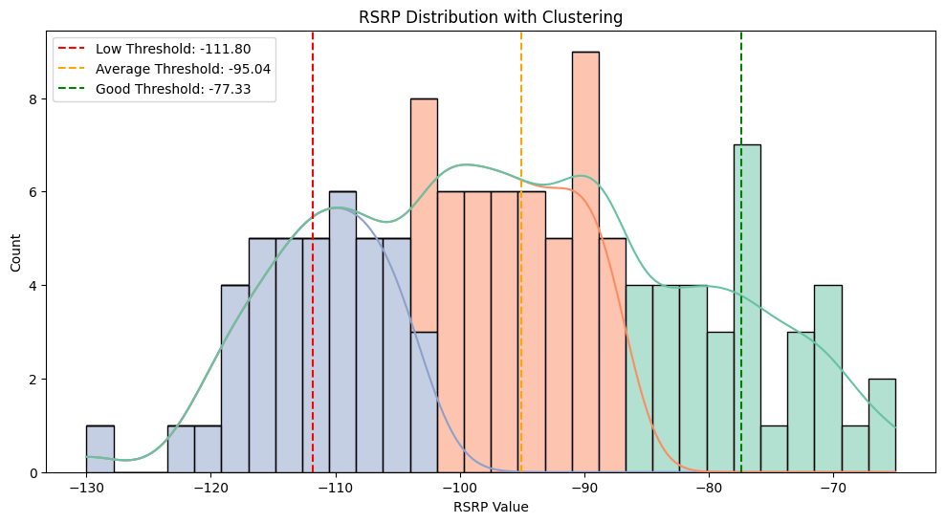
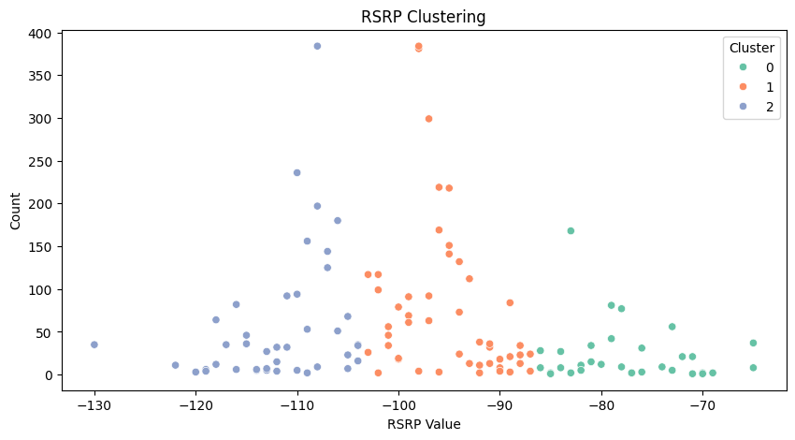
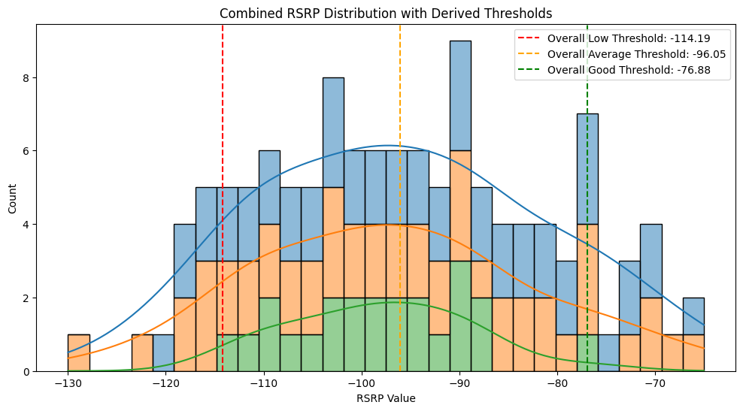
Apply K-Means clustering to group RSRP values
Percentile Thresholds: 0.25,0.50,0.75
Finland -106.75 -94.5 -82.25
Norway -104.50 -98.0 -91.50
Sweden -109.00 -97.0 -84.00
Minimum RSRP Values for Each Country:
Finland -120
Norway -113
Sweden -130
Cluster Centers (RSRP Thresholds)
Finland: [-111.17647058823529, -94.0, -76.875]
Sweden: [-114.1875, -96.5, -77.26666666666667]
Norway: [-108.71428571428572, -98.0, -87.71428571428571]

Slide 26
Key Take Away
RSRP Thresholds: Set RSRP thresholds for switching between V2N, V2I, V2V, and edge server usage to ensure reliable connectivity.
Current Network: The existing 5G NR NSA network in Oulu supports only lower-degree automation
Latency Issue: The 5G NSA network has too high latency for higher-degree automation or fully autonomous driving.
Need for Better Networks: 5G SA or 6G networks with lower latency and higher reliability are needed for fully autonomous driving.
Regional Differences: Autonomous driving capabilities will vary by region—some areas will support full automation, others only lower-degree automation, and some will rely on onboard sensors and periodic broadcasts only.

Slide 27
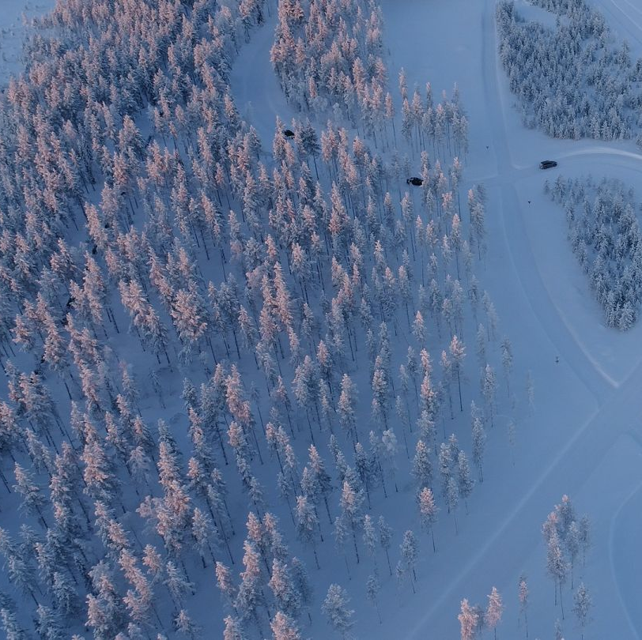
Sodankylä 5G Test Network Intelligent traffic road weather services test track in Sodankylä and autonomous miniature vehicle of FMI
Future Works
How the vehicle speed will affect the RSRP values
How the artic weather conditions affect on V2N network
Test with a 6G modem with similar use cases.
Extended testing on 5G SA network

Slide 28

Thank you

